Slide 1
Analysis of Graduate Admissibility Data
Samantha Riedener

Slide 2
Introduction
Data set focuses on student information
End result is to predict if students are admitted or not

Slide 3
Motivation
Grad school is a major life decision
If you can know how your admissions profile stacks up, it can be easier to know what to work on to improve your chances

Slide 4
Problem Statement
Given a set of parameters, can various data mining technique be used to help predict if a student will be accepted to a graduate program?
Which factors are most important in determining success of admission?

Slide 5
Data Set
Data set looks at admissions from an international (Indian) perspective
Contains 7 variables that describe attributes for a student’s gradate school application:
  GRE Score
  TOEFL Score
  Undergrad university quality
  Statement of Purpose quality
  Letters of Recommendation quality
  CGPA (different than 4.0 GPA scale)
  Research experience?

Slide 6
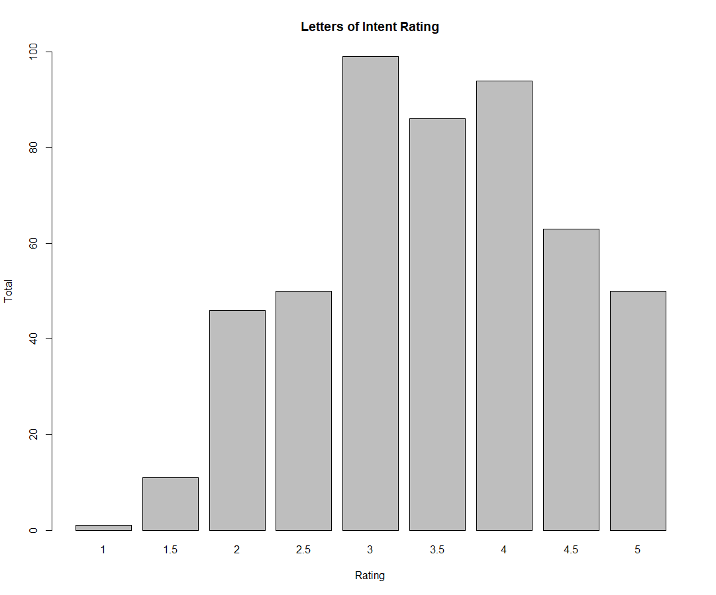
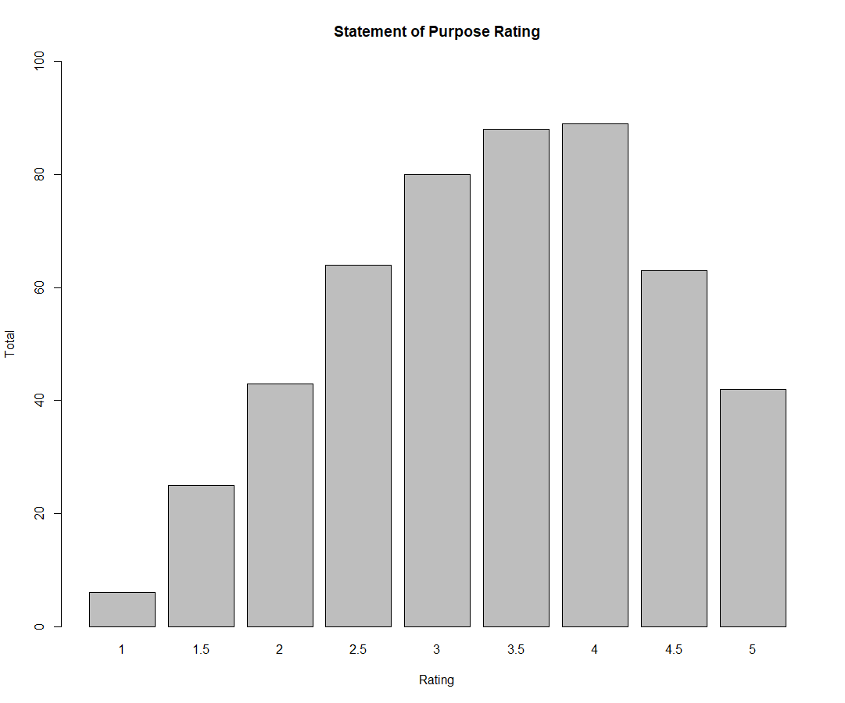
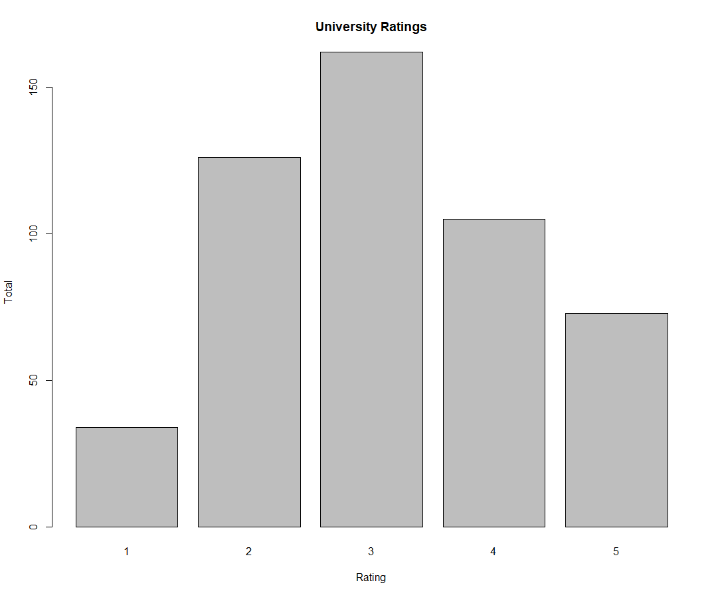
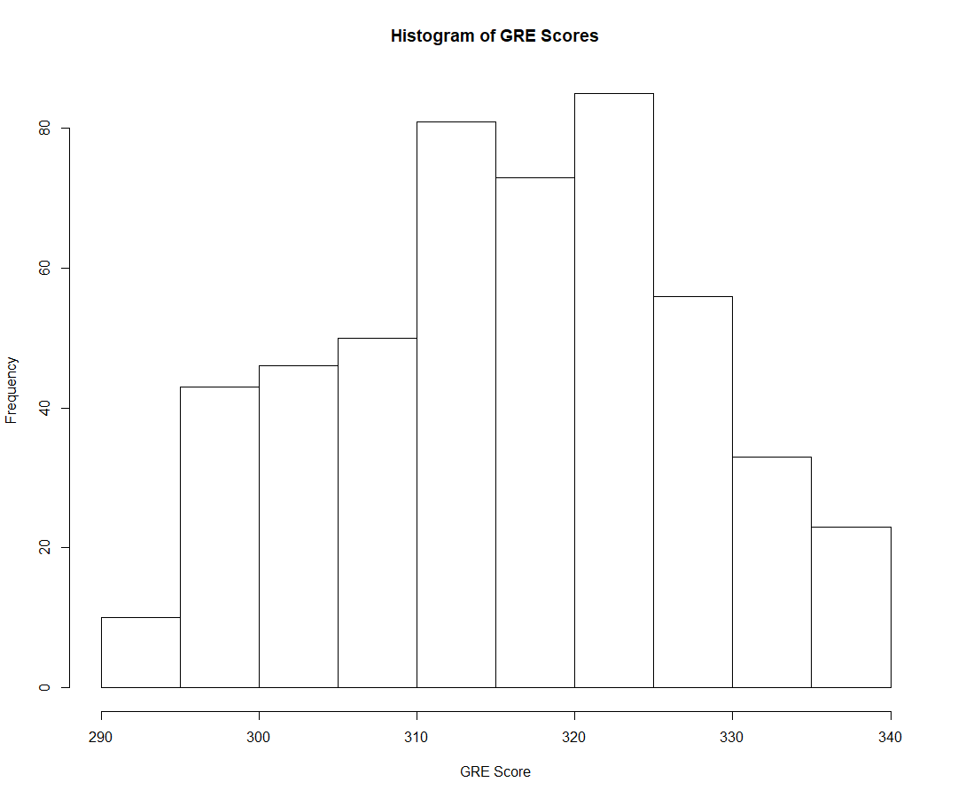
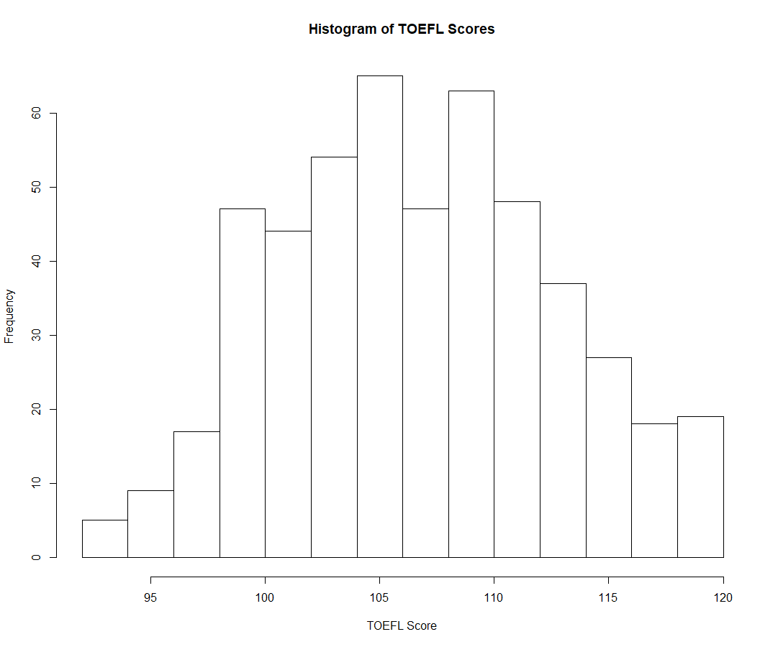
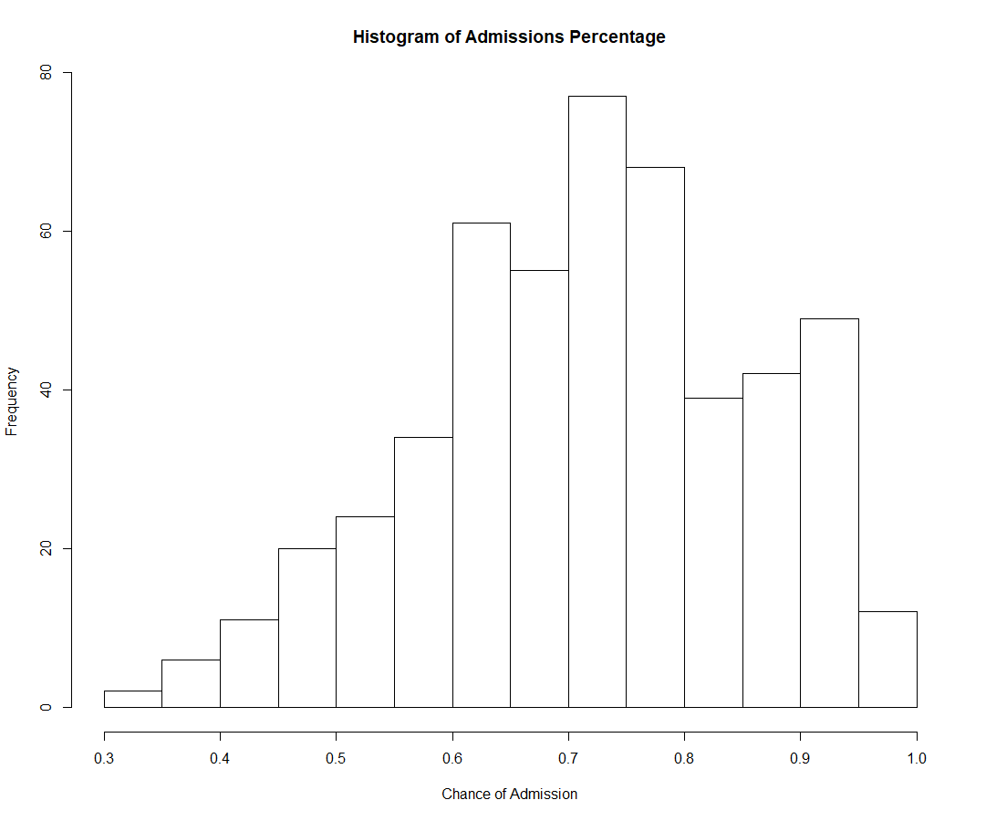
Data Examination and Cleaning

Slide 7
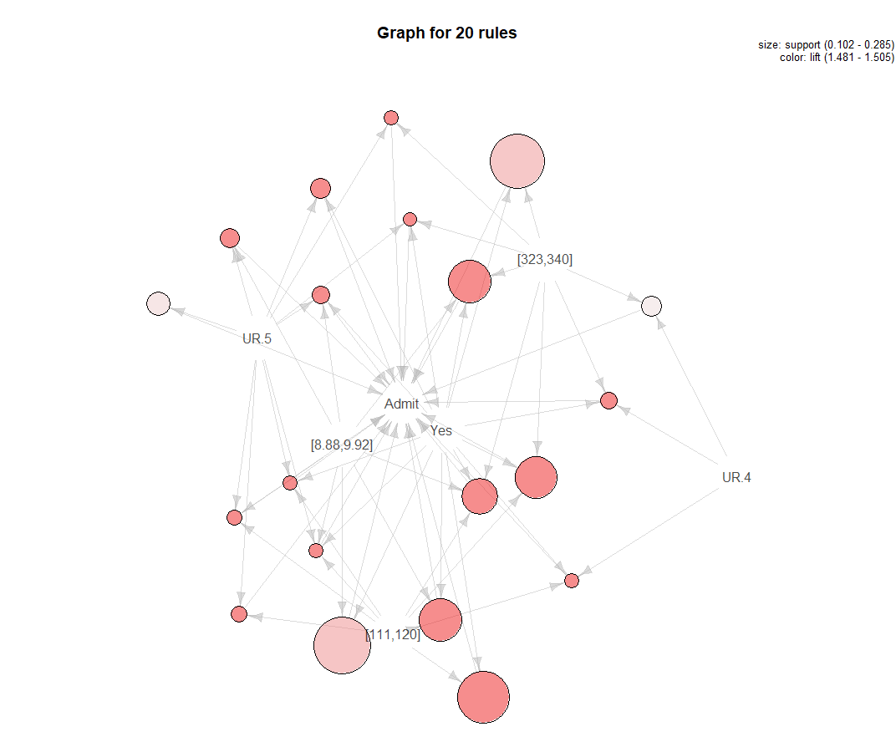
Associative Rule Mining
Additional data cleaning done to make all variables Factors/Discretized
Factors all renamed for readability
lhs rhs support confidence lift count
[1] {[111,120],UR.5} => {Admit} 0.1097804 1.0000000 1.504505 55
[2] {[323,340],UR.5} => {Admit} 0.1037924 1.0000000 1.504505 52
[3] {[8.88,9.92],UR.5} => {Admit} 0.1237525 1.0000000 1.504505 62
[4] {UR.5,Yes} => {Admit} 0.1277445 1.0000000 1.504505 64
[5] {[111,120],Yes} => {Admit} 0.2634731 1.0000000 1.504505 132
[6] {[111,120],[8.88,9.92],UR.5} => {Admit} 0.1077844 1.0000000 1.504505 54
[7] {[111,120],UR.5,Yes} => {Admit} 0.1057884 1.0000000 1.504505 53
[8] {[323,340],UR.5,Yes} => {Admit} 0.1017964 1.0000000 1.504505 51
[9] {[8.88,9.92],UR.5,Yes} => {Admit} 0.1197605 1.0000000 1.504505 60
[10] {[111,120],UR.4,Yes} => {Admit} 0.1057884 1.0000000 1.504505 53
[11] {[323,340],UR.4,Yes} => {Admit} 0.1157685 1.0000000 1.504505 58
[12] {[111,120],[323,340],Yes} => {Admit} 0.2215569 1.0000000 1.504505 111
[13] {[111,120],[8.88,9.92],Yes} => {Admit} 0.2235529 1.0000000 1.504505 112
[14] {[323,340],[8.88,9.92],Yes} => {Admit} 0.2235529 1.0000000 1.504505 112
[15] {[111,120],[8.88,9.92],UR.5,Yes} => {Admit} 0.1057884 1.0000000 1.504505 53
[16] {[111,120],[323,340],[8.88,9.92],Yes} => {Admit} 0.1956088 1.0000000 1.504505 98
[17] {[8.88,9.92],Yes} => {Admit} 0.2854291 0.9930556 1.494057 143
[18] {[323,340],Yes} => {Admit} 0.2734531 0.9927536 1.493602 137
[19] {UR.5} => {Admit} 0.1437126 0.9863014 1.483895 72
[20] {[323,340],UR.4} => {Admit} 0.1277445 0.9846154 1.481358 64
Features present in rules with highest lift:
High TOEFL score (111-120)
High GRE score (323-340)
High CGPA (8.88-9.92)
Research experience
High university ranking (4 or 5)

Slide 8
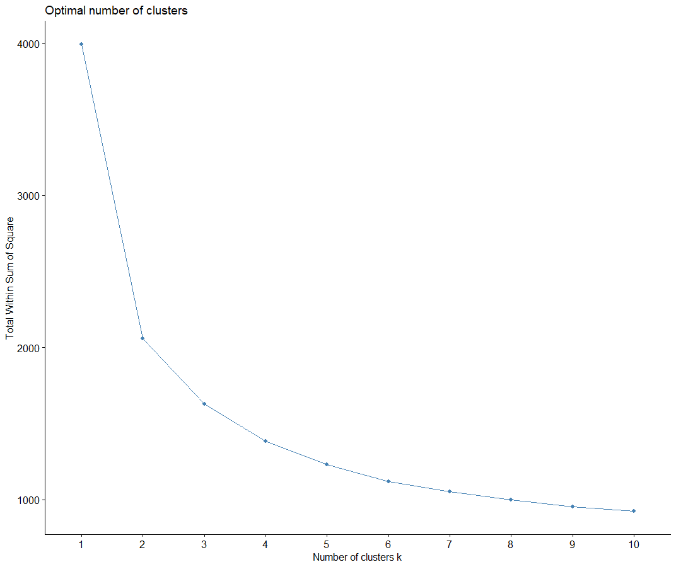
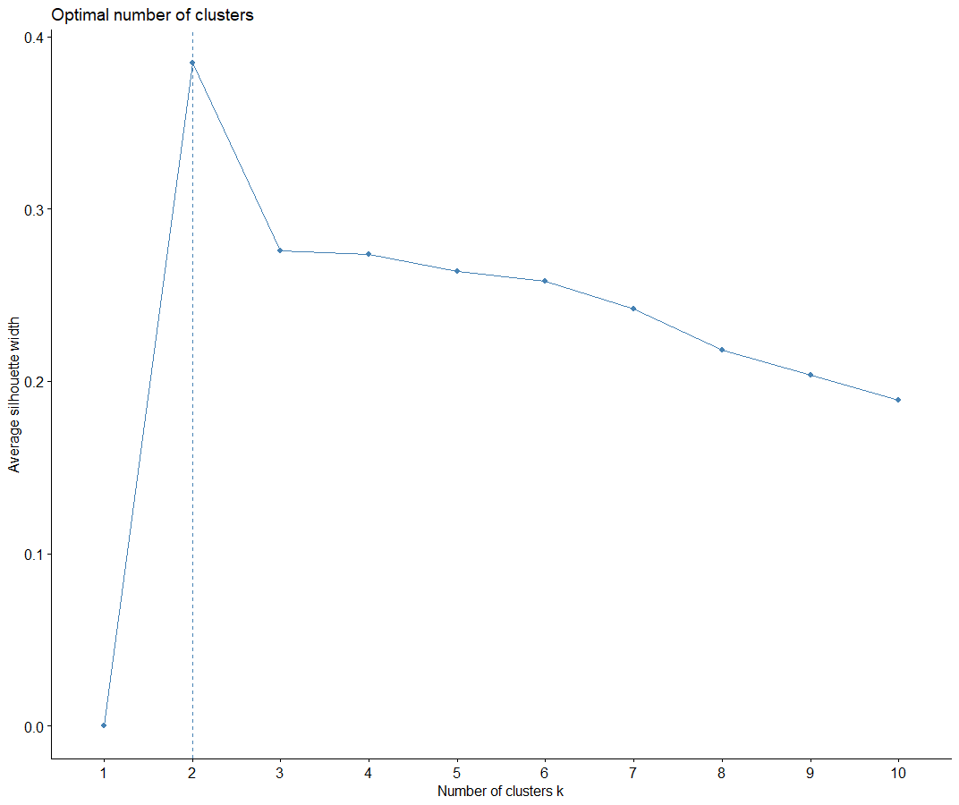
Clustering
Are there unique groupings of students?

Slide 9

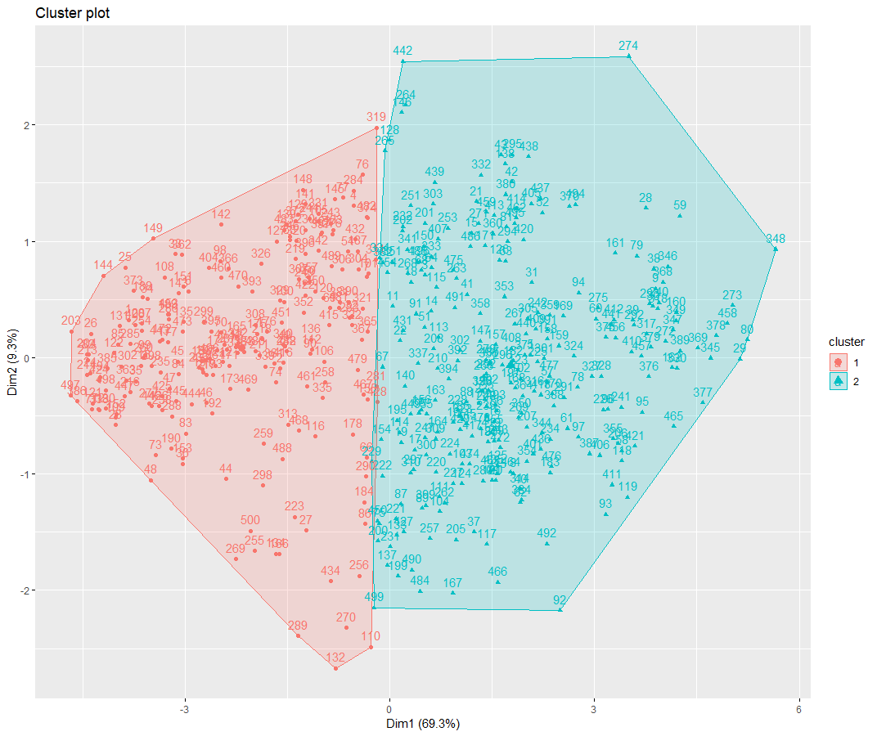
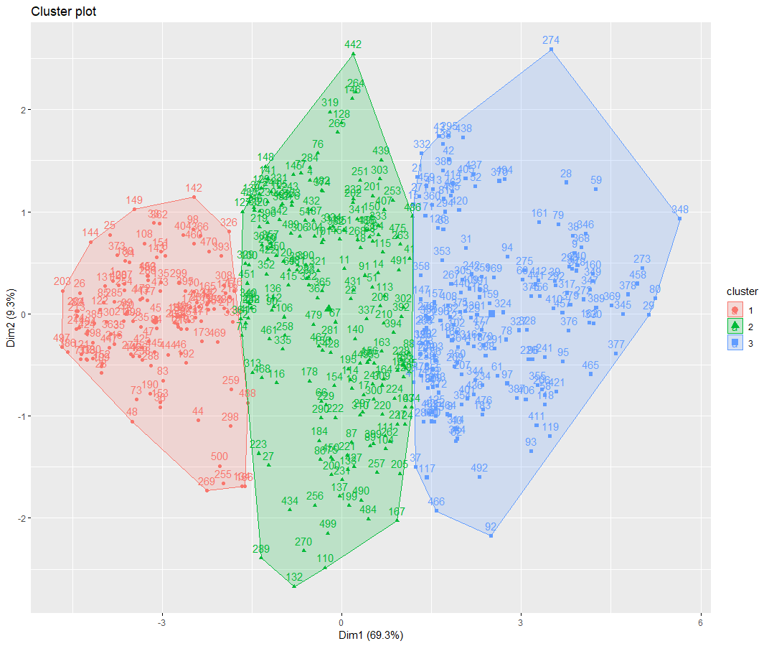
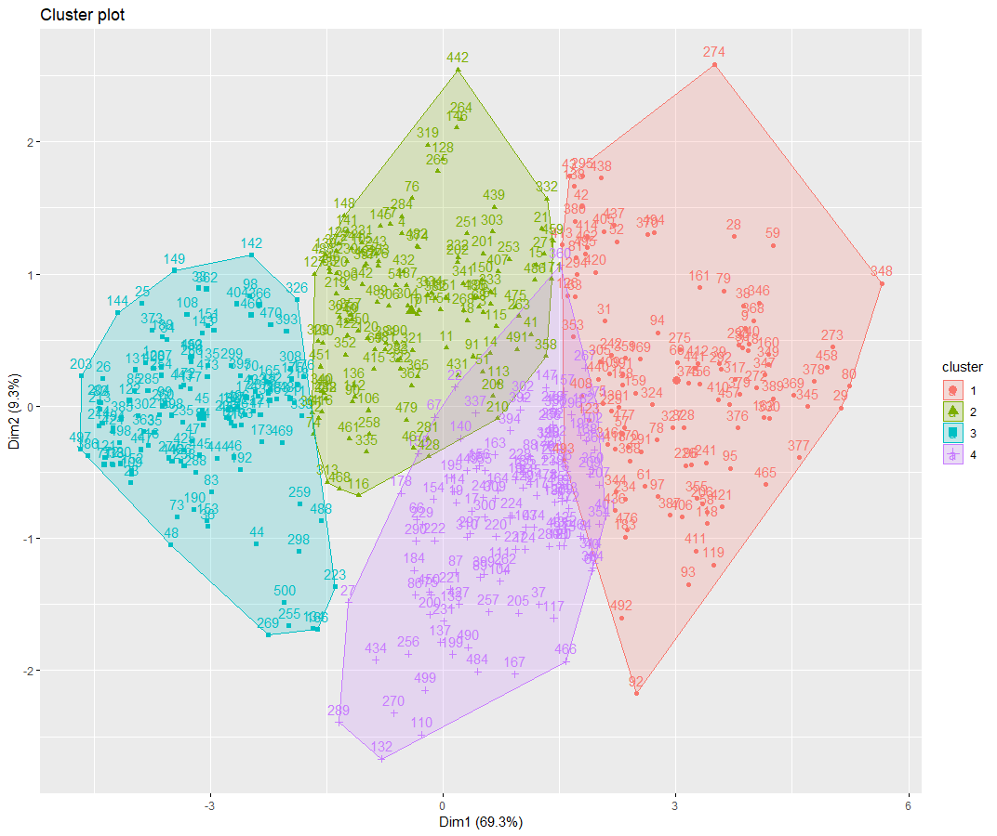
Clustering, cont.

Slide 10
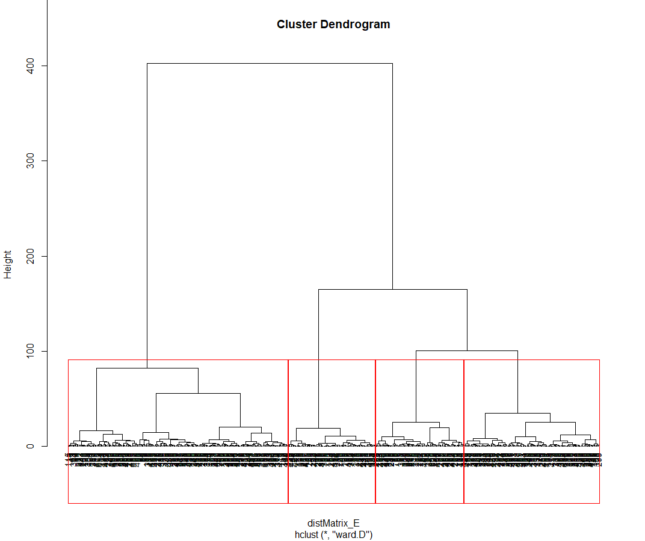
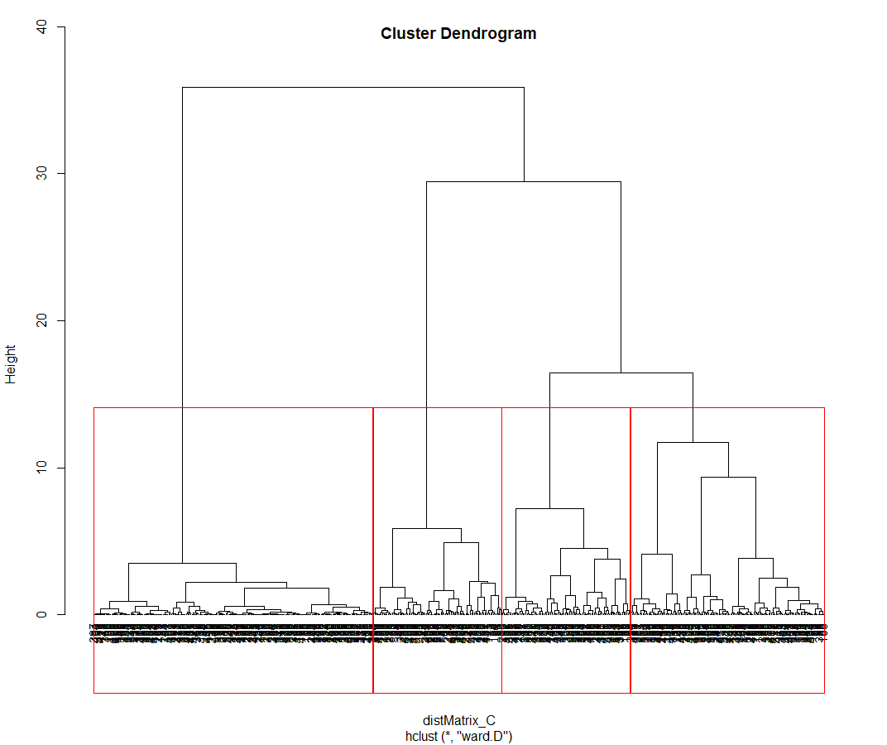
Clustering, cont.

Slide 11
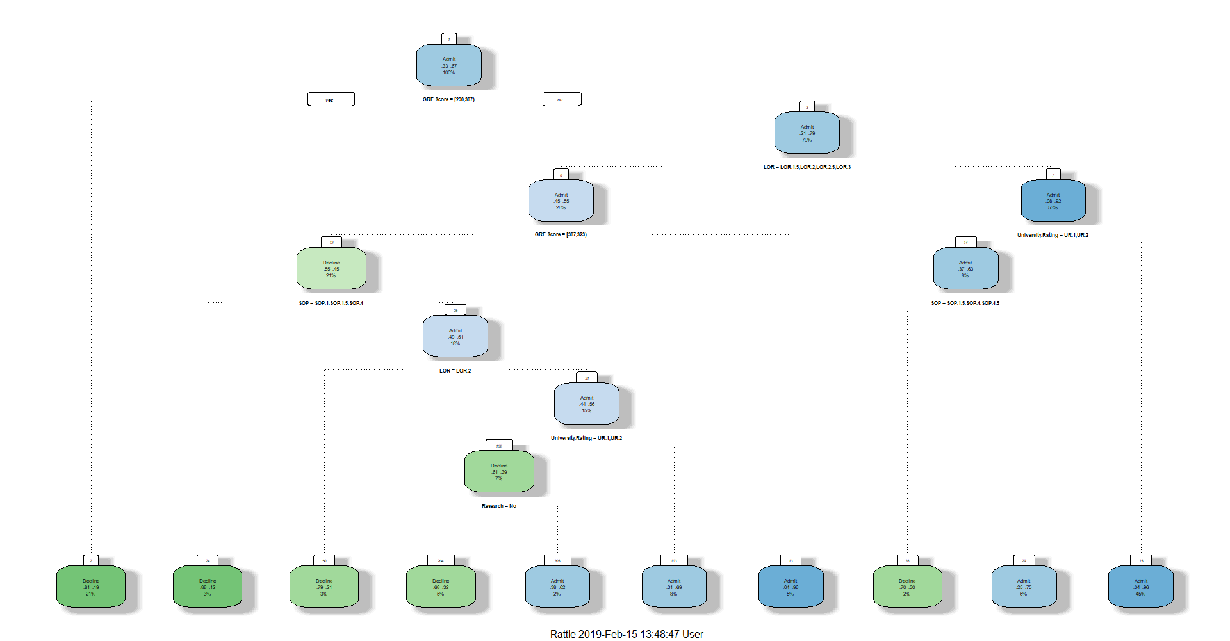
Decision Tree, All Variables

Slide 12
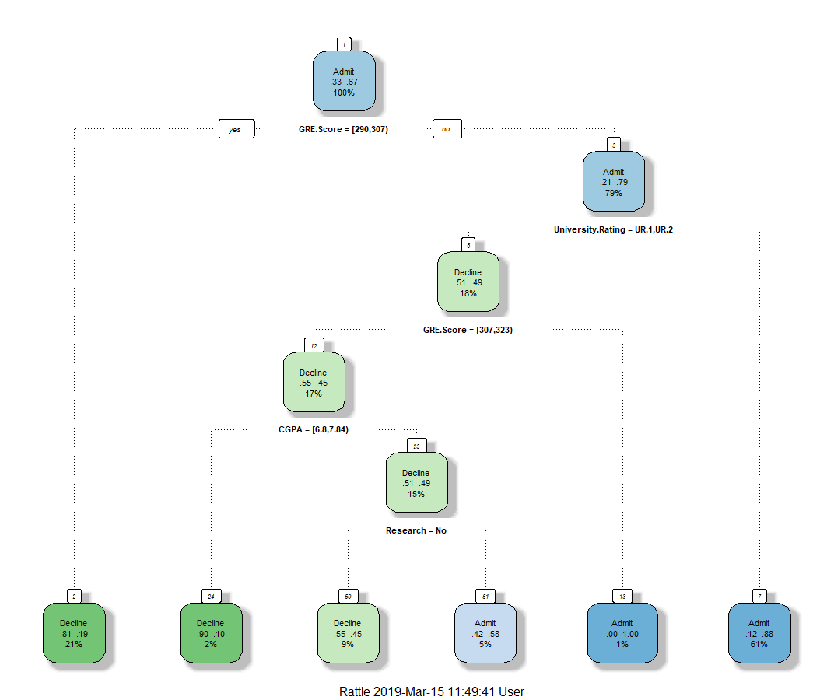
Decision Tree, Pruned

Slide 13



Naïve Bayes
Three algorithms run with different inputs
  All variables
  Variables important to Associative Rules
  Variables important to Decision Tree
1 = Decline, 2 = Accept
All Variables
AR Variables
DT Variables
Parameter | Accuracy | Precision Decline | Recall Decline | Precions Admit | Recall Admit
All Variables | 82.8% | 85.6% | 69.8% | 81.4% | 91.9%
AR Variables | 82.8% | 88.6% | 68.8% | 79.9% | 93.3%
DT Variables | 81.4% | 81.4% | 68.7% | 81.4% | 89.7%

Slide 14









Support Vector Machine
Three different kernels used with three different costs
  Polynomial, linear, and radial at 1, 10, and 100 for the cost
  Would this be better at predicting an outcome than Naive Bayes?
Parameter | Accuracy | Precision Decline | Recall Decline | Precions Admit | Recall Admit
Polynomial, Cost = 1 | 85.4% | 81.4% | 76.4% | 87.4% | 90.4%
Polynomial, Cost = 10 | 86.0% | 80.8% | 79.8% | 88.6% | 90.2%
Polynomial, Cost = 100 | 84.4% | 81.4% | 74.3% | 85.9% | 90.2%
Linear, Cost = 1 | 87.0% | 82.6% | 79.3% | 89.2% | 91.1%
Linear, Cost = 10 | 86.8% | 79.6% | 80.6% | 90.7% | 89.9%
Linear, Cost = 100 | 85.4% | 78.4% | 78.0% | 88.9% | 89.2%
Radial, Cost = 1 | 91.6% | 88.0% | 87.0% | 93.4% | 94.0%
Radial, Cost = 10 | 98.4% | 97.6% | 97.6% | 98.8% | 98.8%
Radial, Cost = 100 | 99.8% | 100.0% | 99.4% | 99.7% | 100.0%

Slide 15
Conclusions
Difference analytical methods determined different factors were most important
The three most consistent factors were GRE Score, University Rating, and Research Experience
Support vector machine made the most accurate prediction method
Further analysis includes testing data sets, data from students from other countries

